Slide 1

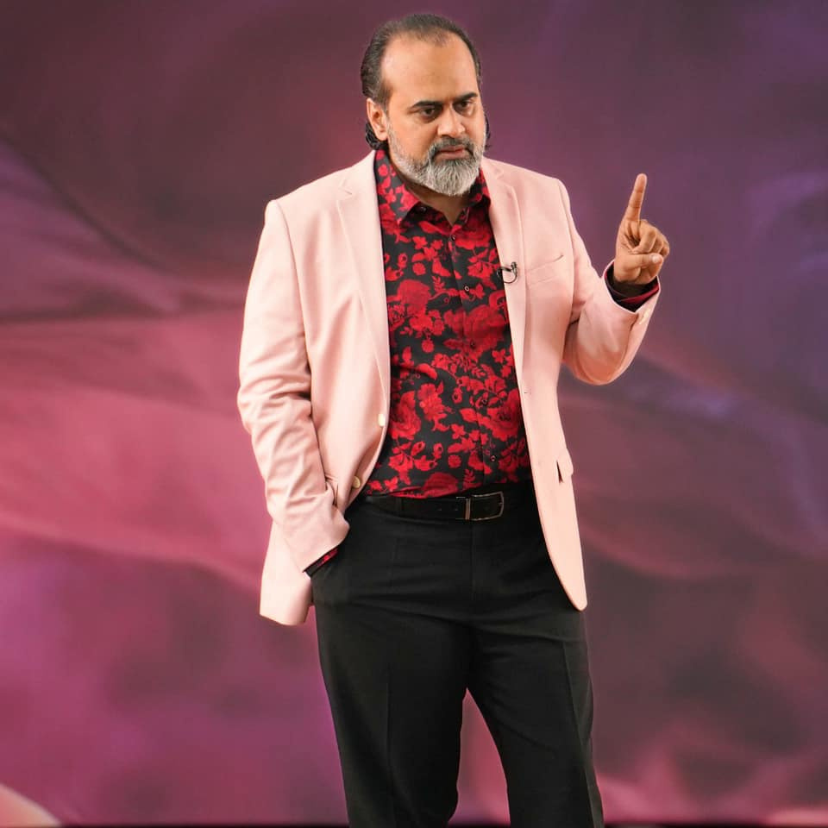
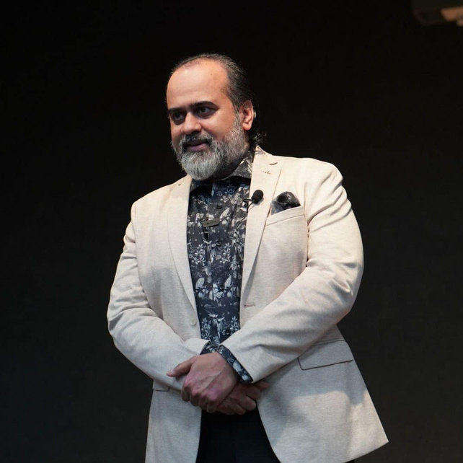







MOTIVAIONAL SPEAKER
Acharya Prashant
Acharya Prashant is a renowned motivational speaker, spiritual teacher, and author who blends ancient wisdom with modern logic. Known for his direct and thought-provoking approach, he inspires individuals to overcome conditioning, embrace truth, and lead fulfilling lives. His talks empower seekers to find clarity, purpose, and inner freedom in life’s challenges.
+91 9650585100
On a computer, press CTRL + Click on the icon; on a mobile, simply tap the icon to proceed.

Slide 2

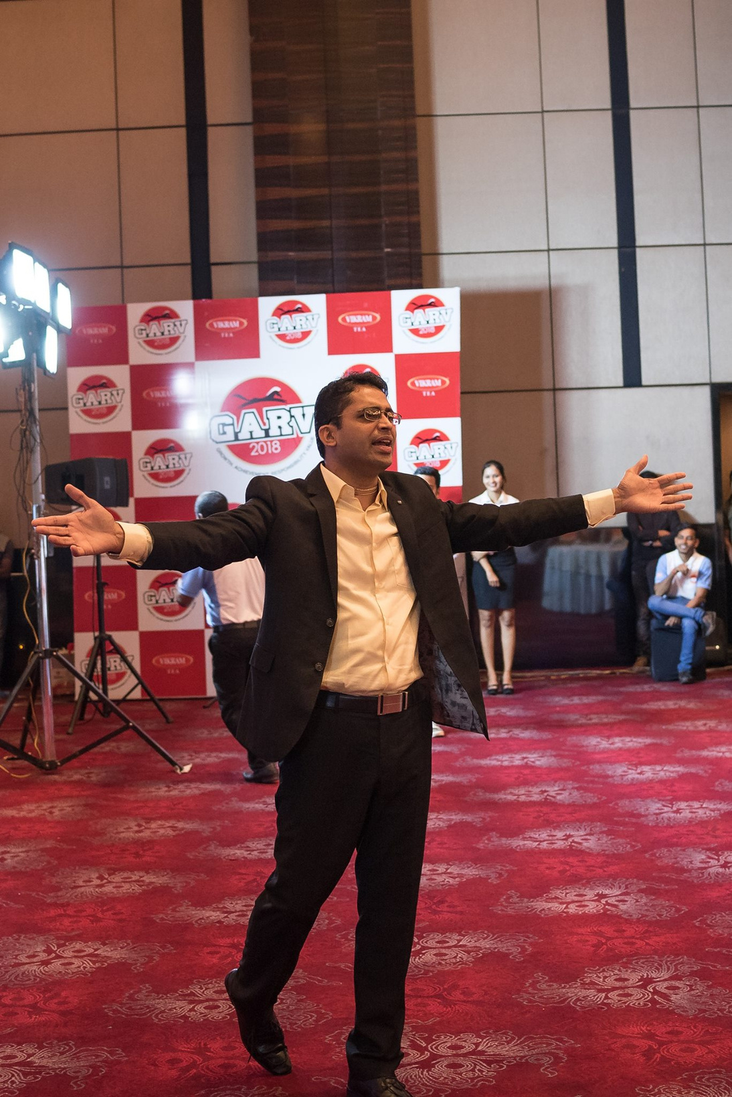
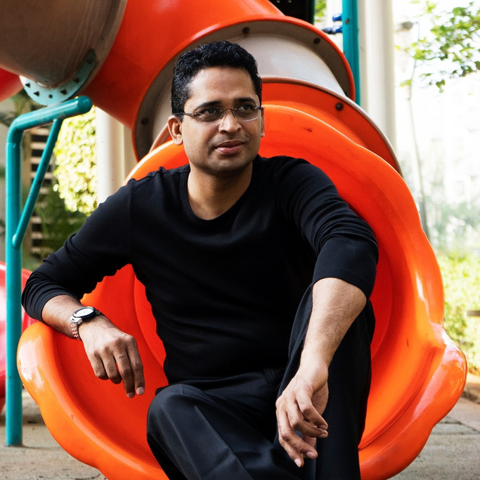

MOTIVAIONAL SPEAKER
Anand Munshi
Akanksha Negi is an inspiring motivational speaker known for her impactful sessions on personal growth, resilience, and leadership. With her dynamic communication style, she empowers individuals to overcome challenges, achieve their goals, and unlock their full potential. Her relatable approach and positive energy leave audiences motivated to create meaningful change.
+91 96044 36000
On a computer, press CTRL + Click on the icon; on a mobile, simply tap the icon to proceed.

Slide 3
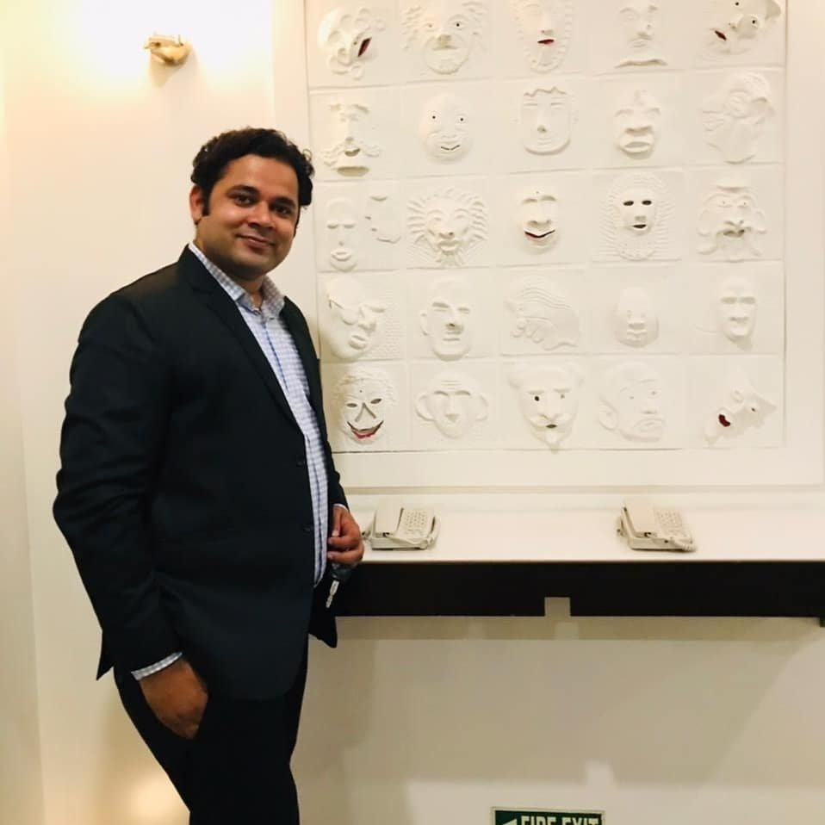
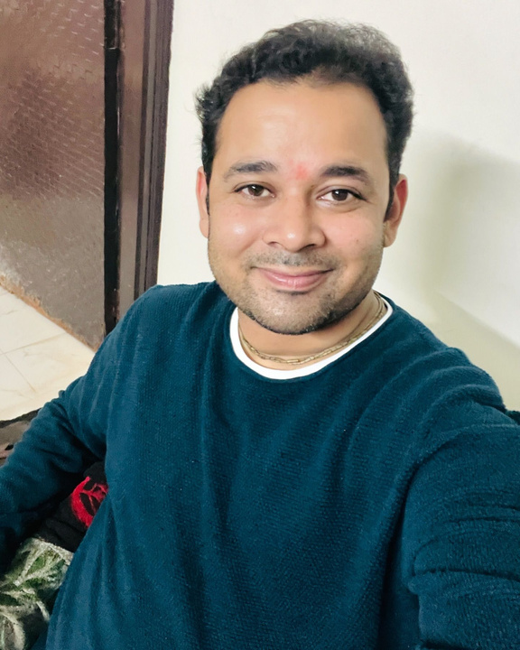

MOTIVAIONAL SPEAKER
Prashant Sharma
Prashant Sharma is a motivational speaker, corporate trainer, and leadership coach known for his expertise in personal development and professional growth. With an engaging style and practical insights, he empowers individuals to overcome challenges, enhance productivity, and achieve success. His inspiring sessions focus on mindset transformation, leadership skills, and goal achievement.
095601 88930
On a computer, press CTRL + Click on the icon; on a mobile, simply tap the icon to proceed.

Slide 4
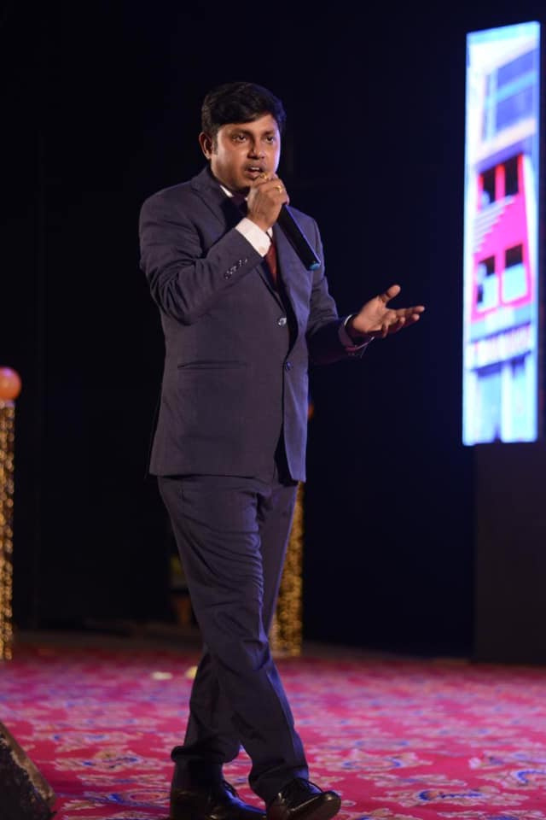
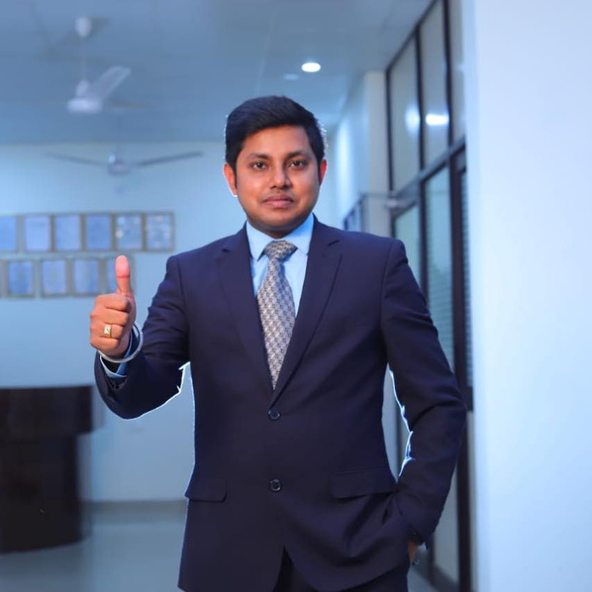
MOTIVAIONAL SPEAKER
Raghunandan Pandey
Raghunandan Pandey is a motivational speaker, educator, and mentor known for his impactful sessions on personal development, career guidance, and leadership. With his practical insights and engaging communication style, he inspires individuals to overcome challenges, build confidence, and achieve their goals. His teachings emphasize self-discipline, positivity, and purposeful living.
099682 11032
On a computer, press CTRL + Click on the icon; on a mobile, simply tap the icon to proceed.

Slide 5
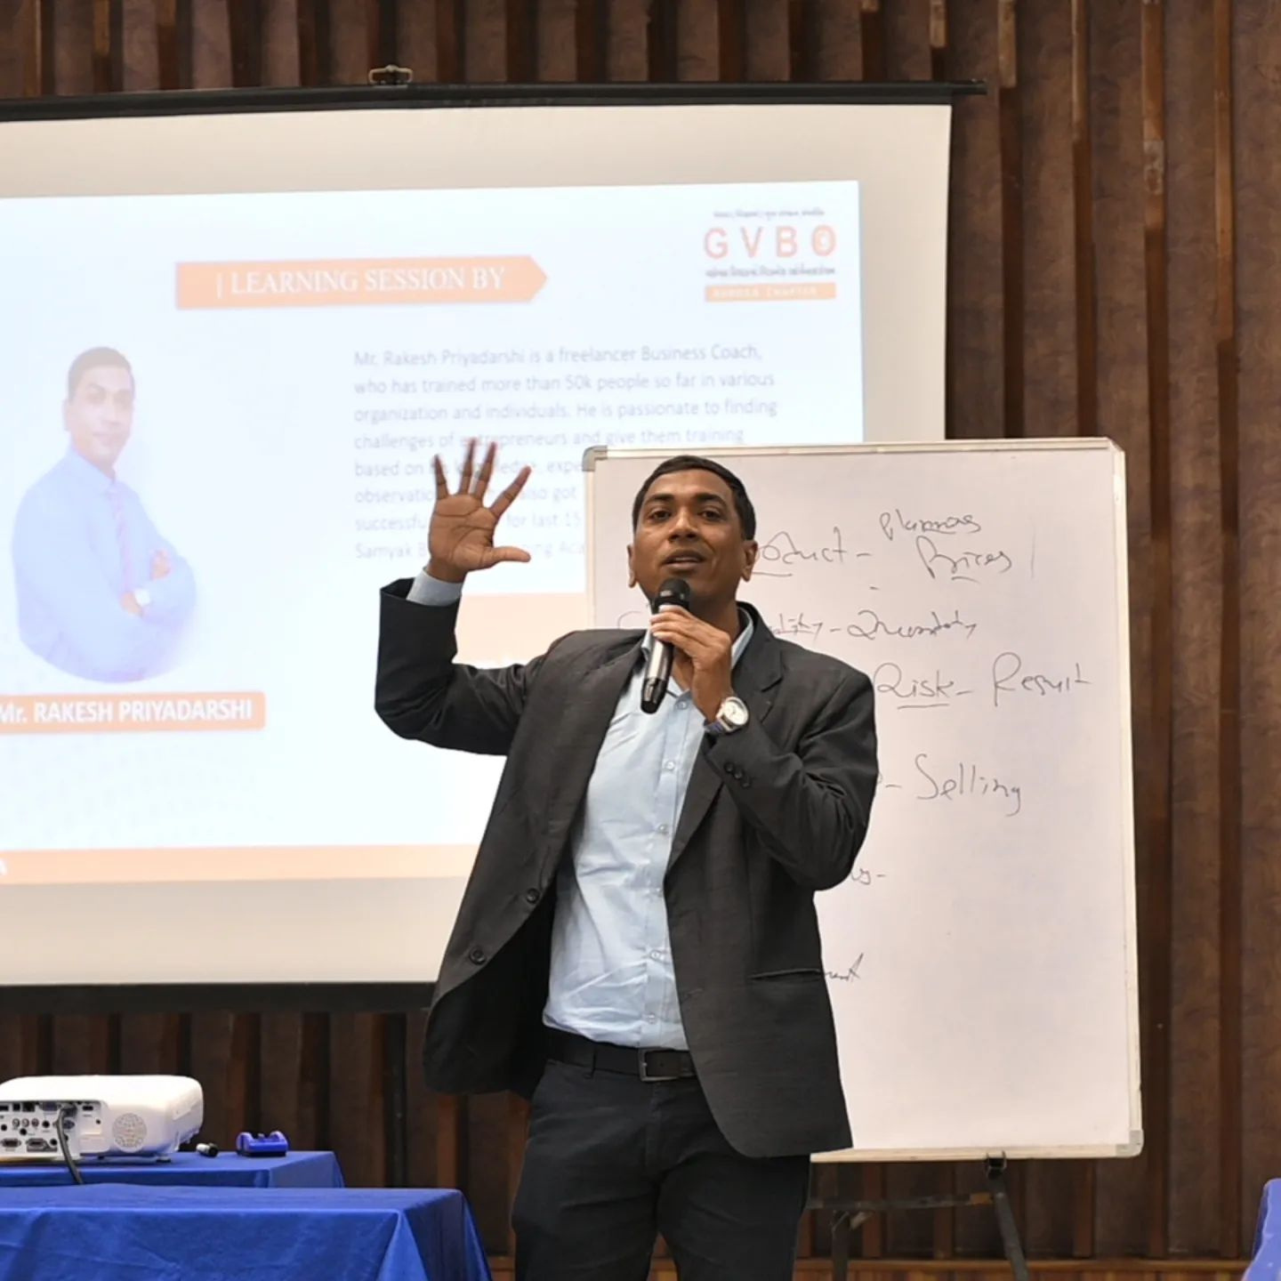
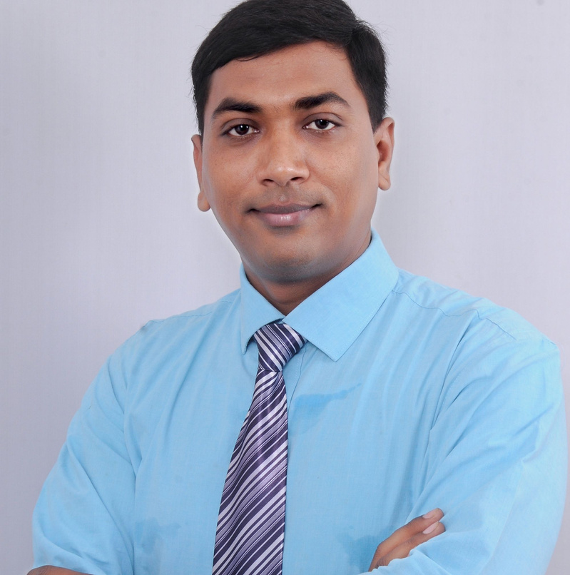


MOTIVAIONAL SPEAKER
Rakesh Priyadarshi
Rakesh Priyadarshi is a motivational speaker, life coach, and leadership trainer known for his empowering sessions on personal development, career growth, and overcoming challenges. His practical approach to building a positive mindset, resilience, and success strategies inspires individuals to achieve their goals and create lasting positive changes in their lives.
On a computer, press CTRL + Click on the icon; on a mobile, simply tap the icon to proceed.

Slide 6

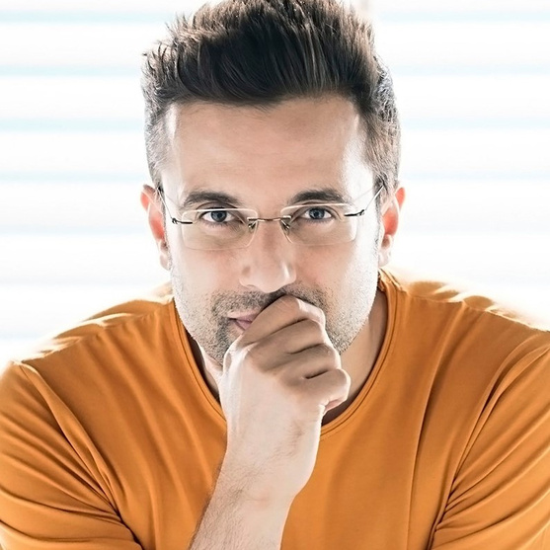

MOTIVAIONAL SPEAKER
Sandeep Maheshwari
Sandeep Maheshwari is a renowned motivational speaker, entrepreneur, and philanthropist, celebrated for his inspirational talks and life-changing seminars. Founder of ImagesBazaar, he is known for simplifying complex life concepts, empowering individuals to overcome challenges and achieve their dreams. Sandeep’s powerful messages on self-belief, positivity, and purpose resonate with millions worldwide.
On a computer, press CTRL + Click on the icon; on a mobile, simply tap the icon to proceed.

Slide 7
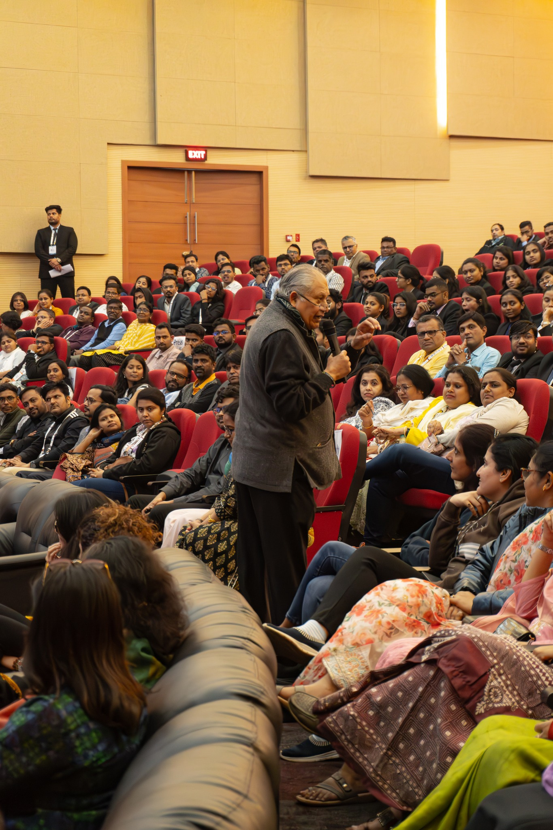
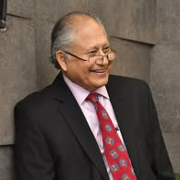
MOTIVAIONAL SPEAKER
Shiv Khera
Shiv Khera is a globally renowned motivational speaker, author, and business consultant best known for his bestselling book You Can Win. His teachings focus on attitude, leadership, and achieving success through ethical practices. Shiv Khera inspires individuals and organizations to unlock their potential, overcome challenges, and create a purposeful, value-driven life.
9811039945
On a computer, press CTRL + Click on the icon; on a mobile, simply tap the icon to proceed.

Slide 8
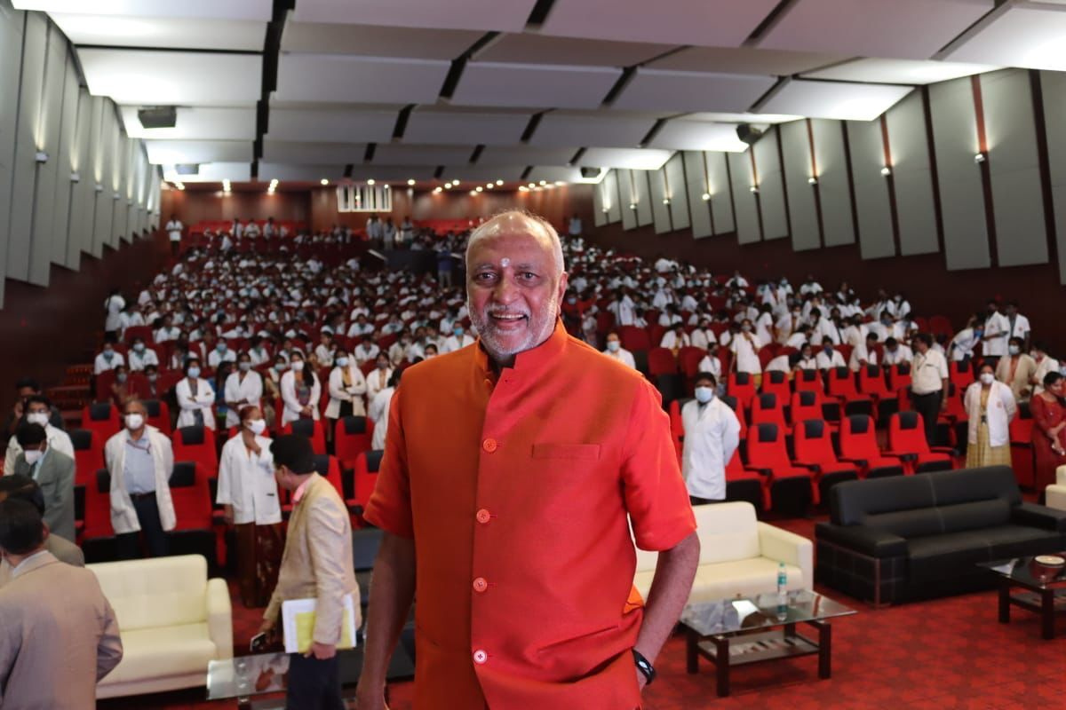
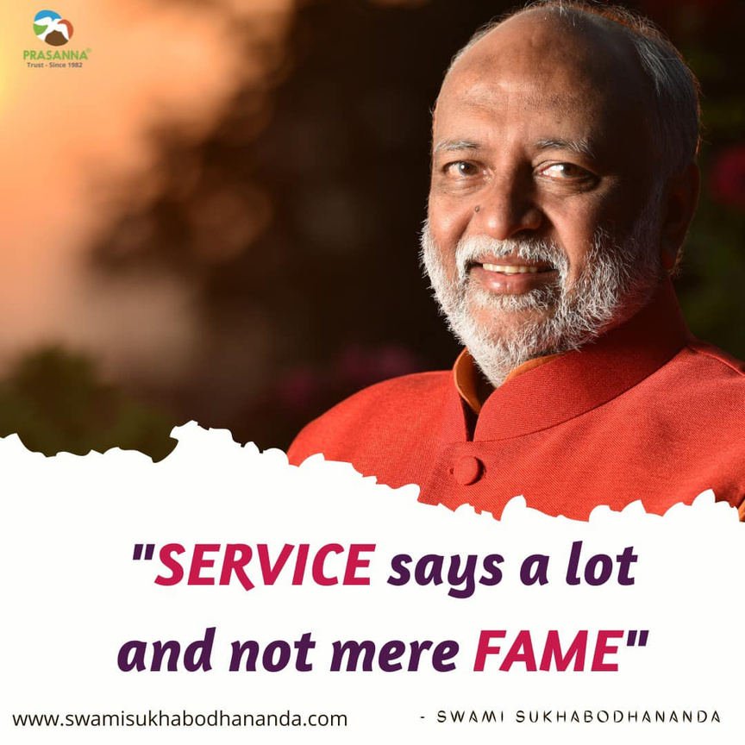

MOTIVAIONAL SPEAKER
Swami Sukhabodhananda
Swami Sukhabodhananda is a renowned spiritual leader, author, and motivational speaker from India, often referred to as the "Corporate Guru." He is the founder of Prasanna Trust, an organization dedicated to promoting self-awareness and spiritual well-being through teachings based on ancient wisdom tailored for modern times.
063666 01235
+91 95135 60103
On a computer, press CTRL + Click on the icon; on a mobile, simply tap the icon to proceed.

Slide 9
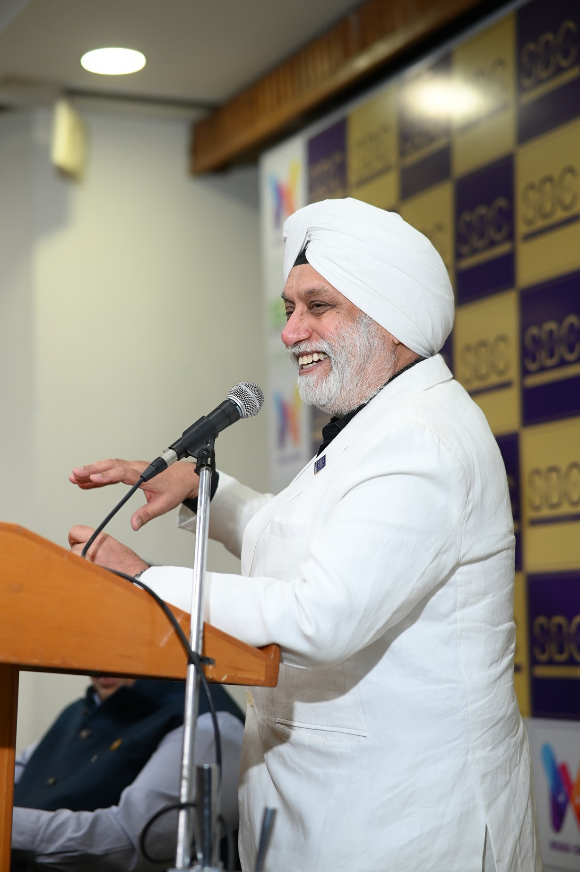
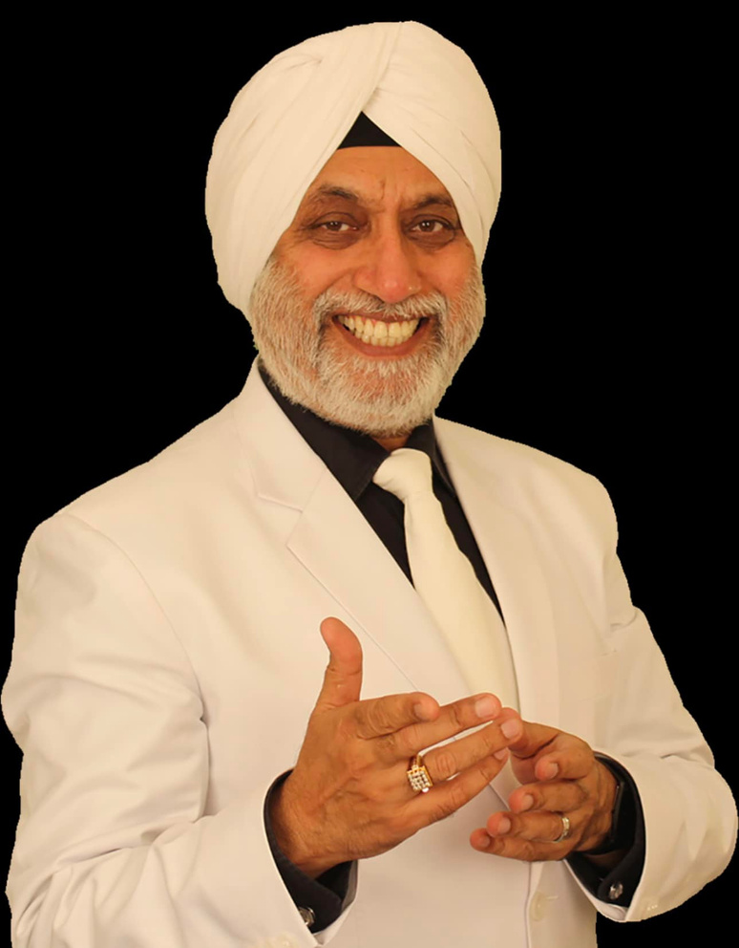
MOTIVAIONAL SPEAKER
T S Madaan
T.S. Madaan is a prominent motivational speaker, life coach, and author, known for his dynamic and impactful sessions on personal growth, leadership, and success. With his engaging style and practical advice, he empowers individuals and organizations to overcome challenges, develop a positive mindset, and achieve their goals.
9810656393
On a computer, press CTRL + Click on the icon; on a mobile, simply tap the icon to proceed.

Slide 10
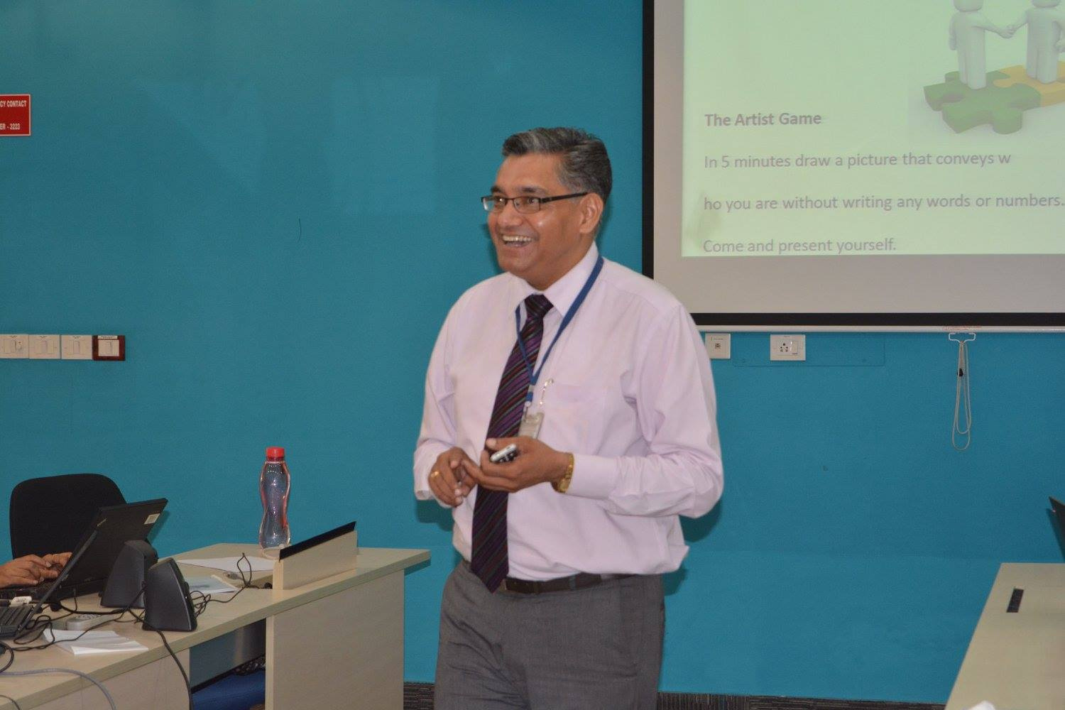
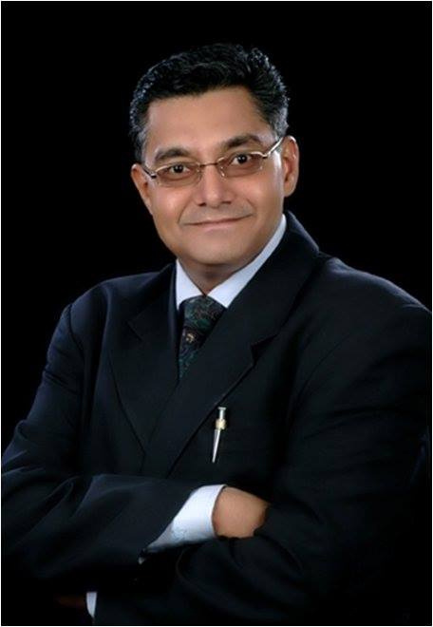

MOTIVAIONAL SPEAKER
Vipin Sarin
Vipin Sarin is a motivational speaker, life coach, and entrepreneur, known for his inspiring sessions on personal growth, resilience, and leadership. With a focus on mindset transformation and overcoming challenges, he empowers individuals to unlock their potential and achieve success in both personal and professional spheres. Vipin’s practical and relatable approach makes him a sought-after mentor and guide.
+98 11 0836 9485
On a computer, press CTRL + Click on the icon; on a mobile, simply tap the icon to proceed.

